Slide 1


Exploring Cellular Heterogeneity and Activities via Gene Co-Expression Graph Topology Structures
Jichun Xie

Slide 2
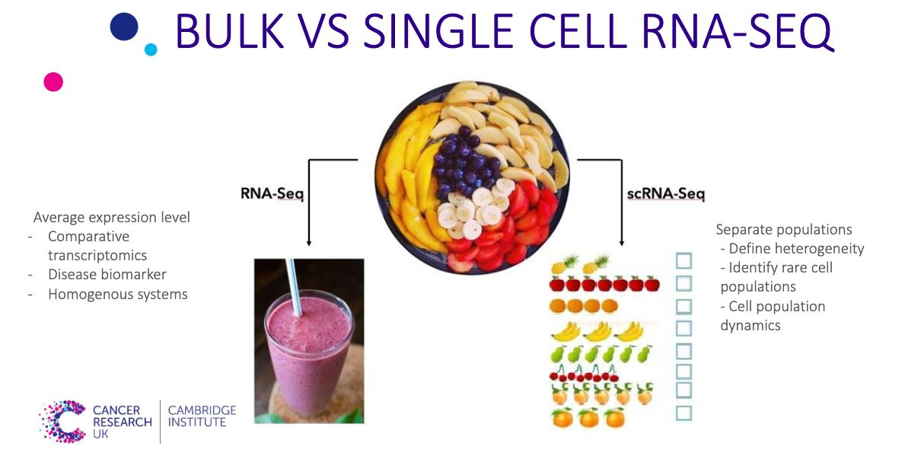
https://www.htgmolecular.com/blog/2022-11-01/considerations-when-planning-single-cell-rna-sequencing-analysis

Slide 3
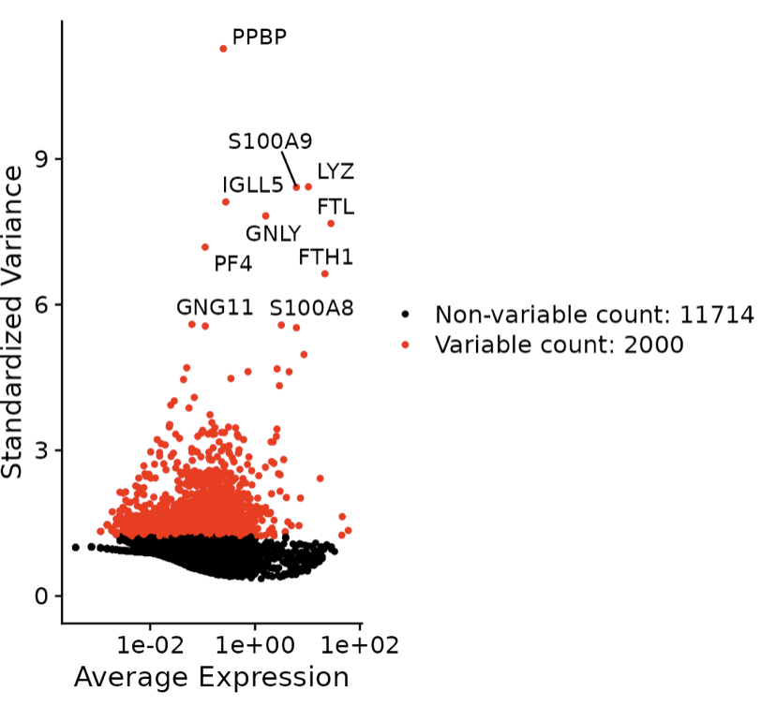
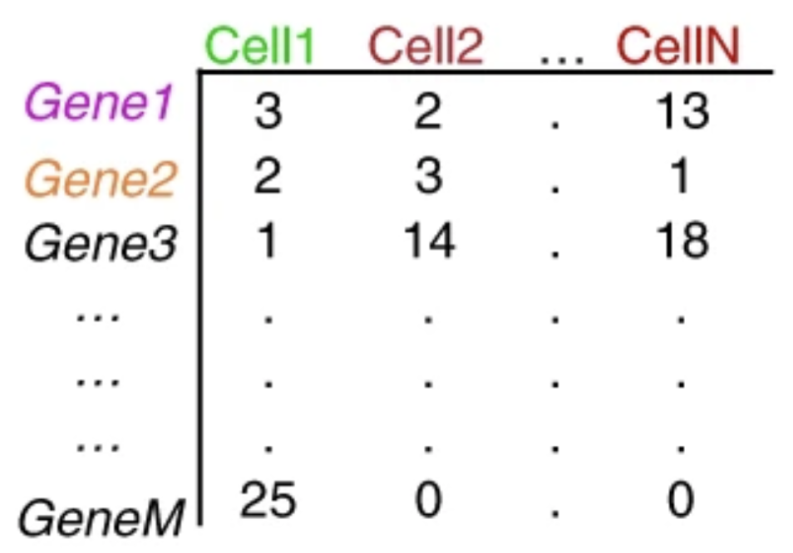
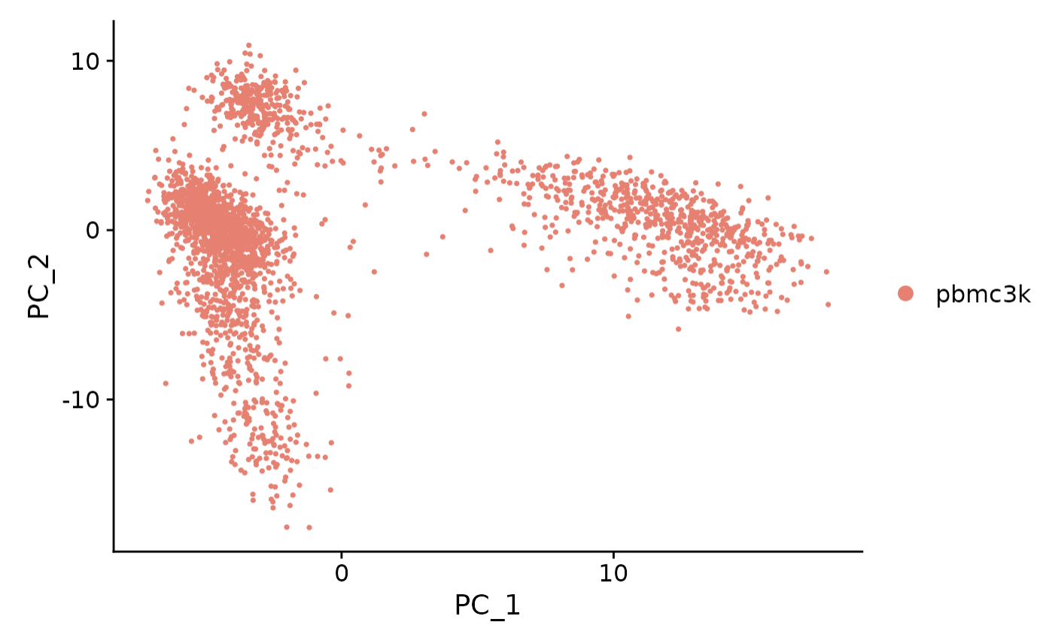
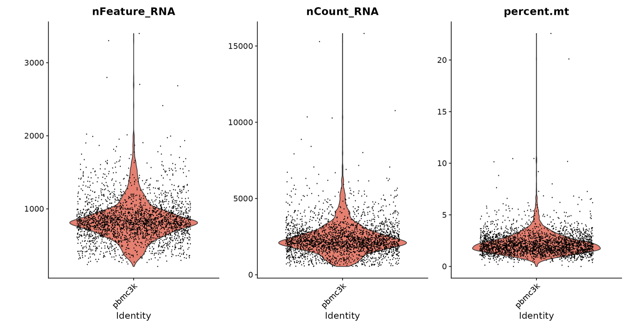

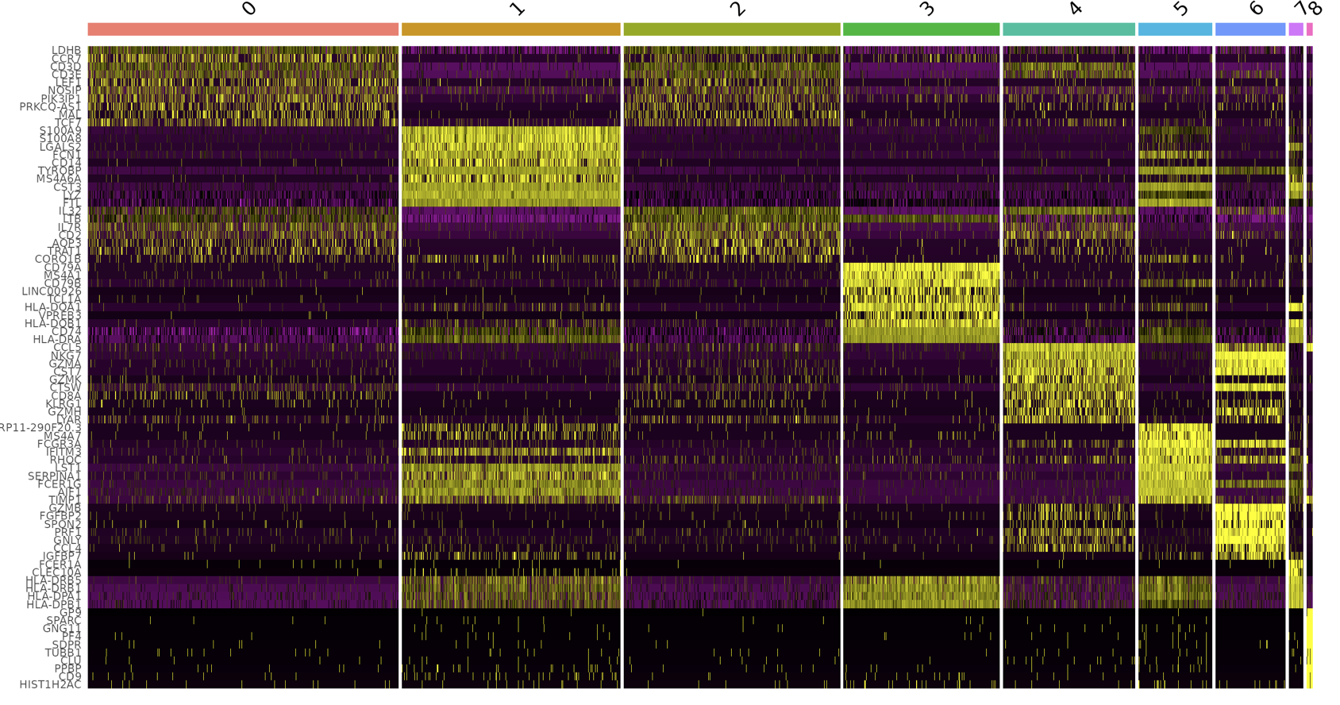
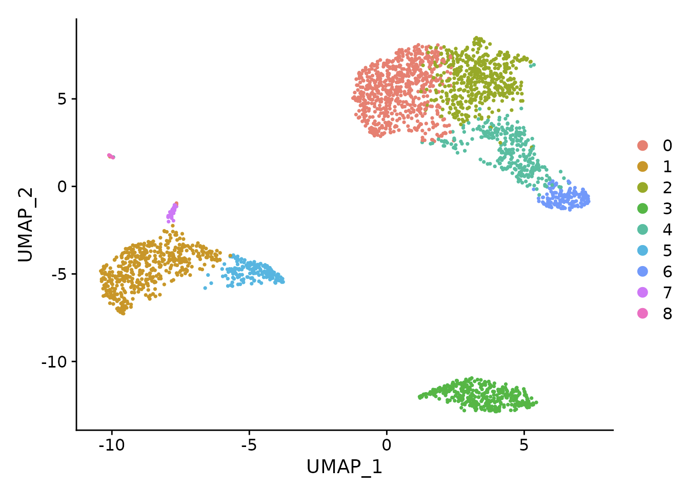
Standard pipeline of single-cell sequencing analysis
Normalization
Input
Quality Control
Feature selection
Dimension reduction
Annotating clusters
Finding differentially expressed features (cluster biomarkers)
Clustering

Slide 4
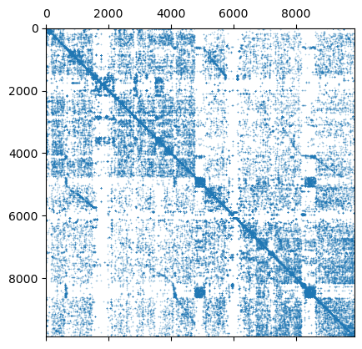
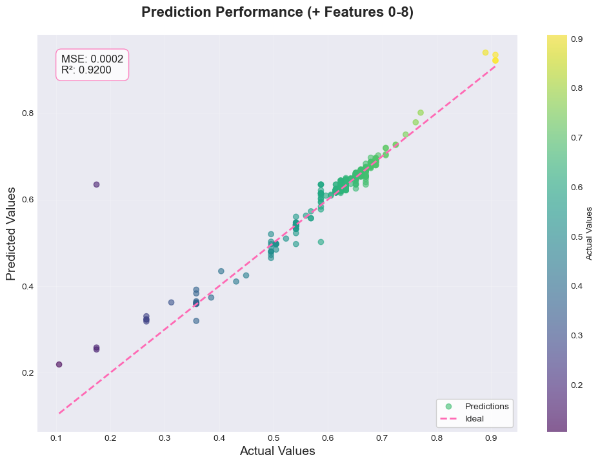
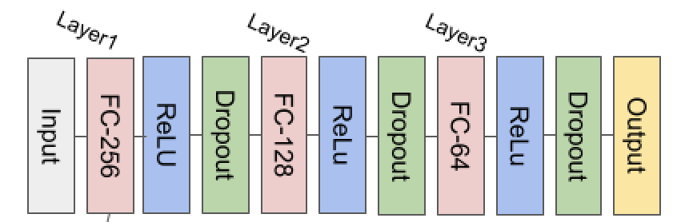
Pipeline
Normalization
Input
Quality Control
Feature selection
Graph construction
Results
Neural Network
Graph affiliated Clustering
Adapted from Jichun Xie, 2024, [Presentation Slides]Exploring Cellular Heterogeneity and Activities via Gene Co-Expression Graph Topology Structures
Notes:
[]

Slide 5
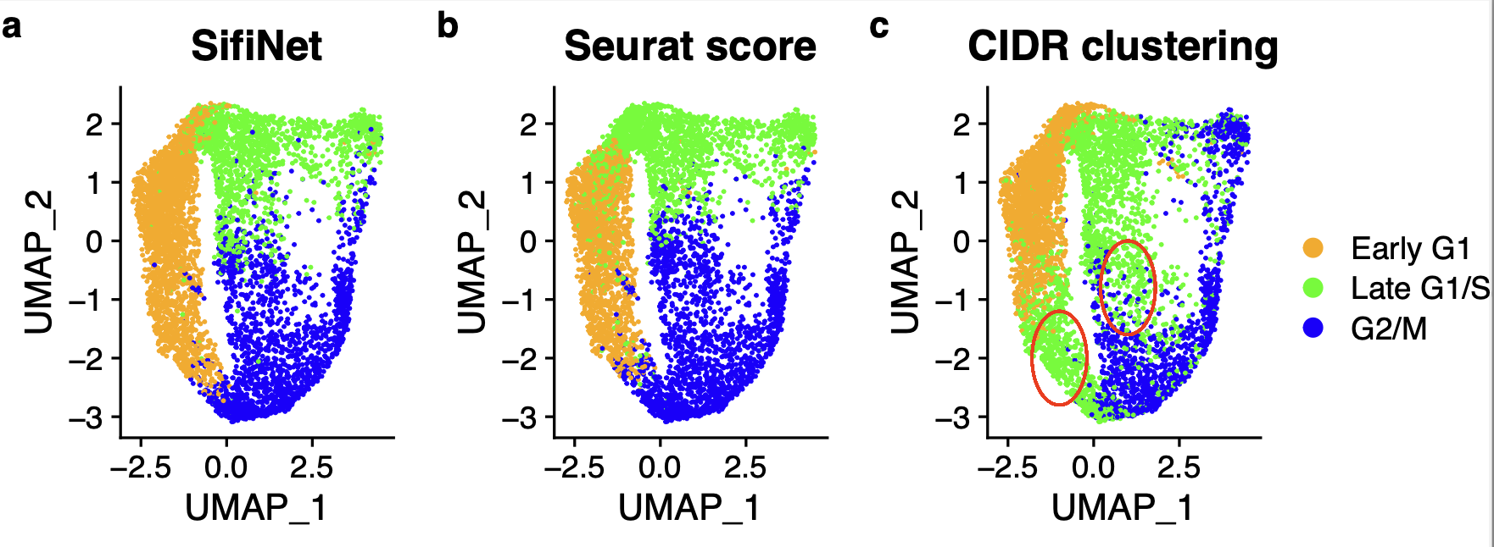
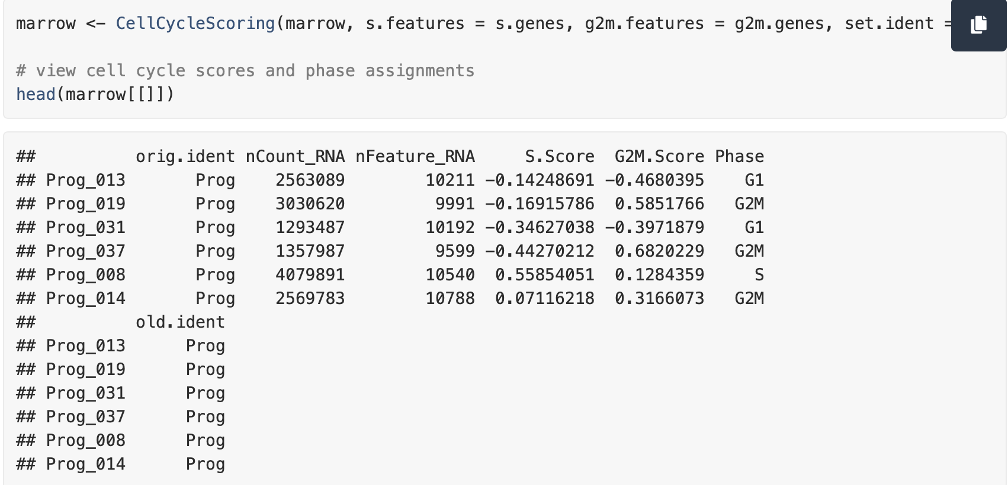
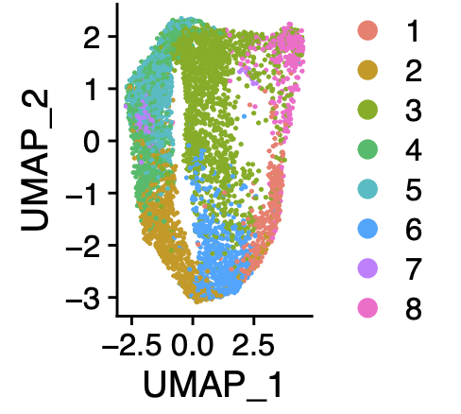
A study on cell cycles
CIDR clustering at the default resolution

Slide 6
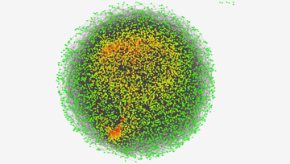
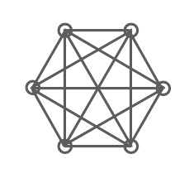

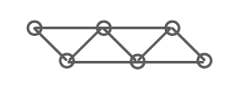
Gene Co-expression Graph
Gene Co-expression Graph
Nodes: Genes
Edges: Gene pair co-expression
Gene co-expression topology
feature genes
Pathway genes
Hub genes

Slide 7
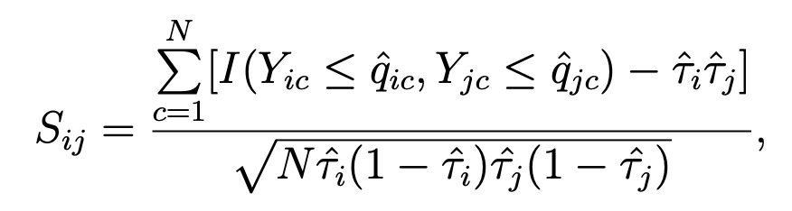
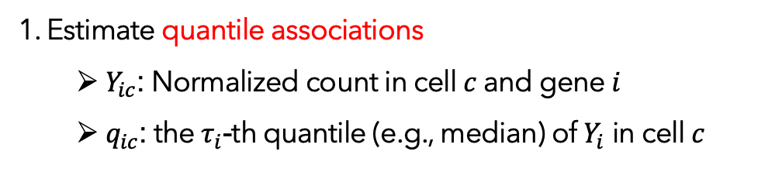
Co-expression graph construction
1. Estimate quantile associations
$Y_{ic}$: Normalized count in cell $c$ and gene $i$
$q_{ic}$: the $τ_{i}$-th quantile (e.g., median) of $Y_{i}$ in cell $c$
2. Perform hypothesis testing: modified BH procedure
3. Further quality control

Slide 8
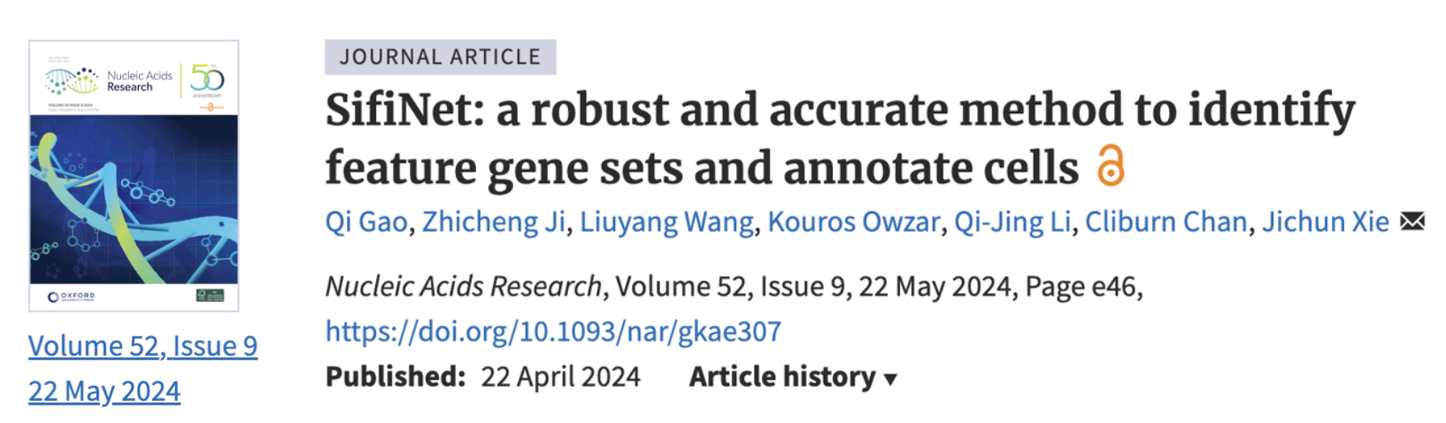


SifiNet

Slide 9
A study on cell cycles
CIDR clustering at the default resolution

Slide 10
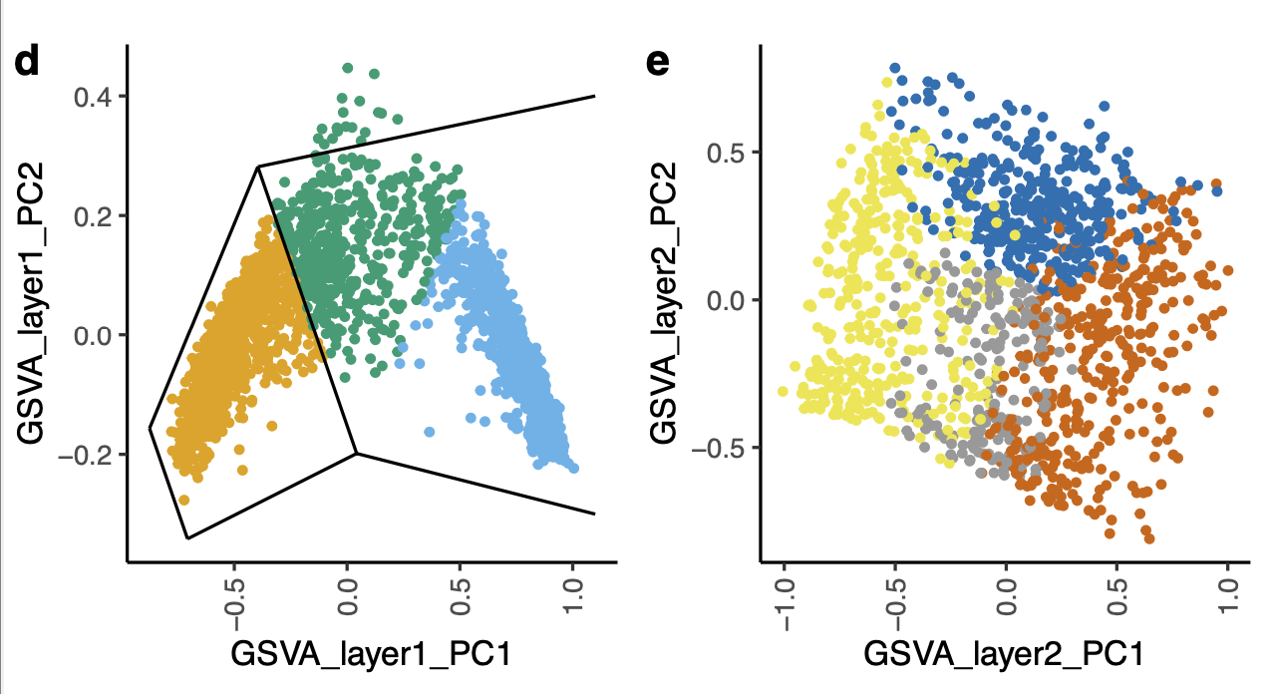
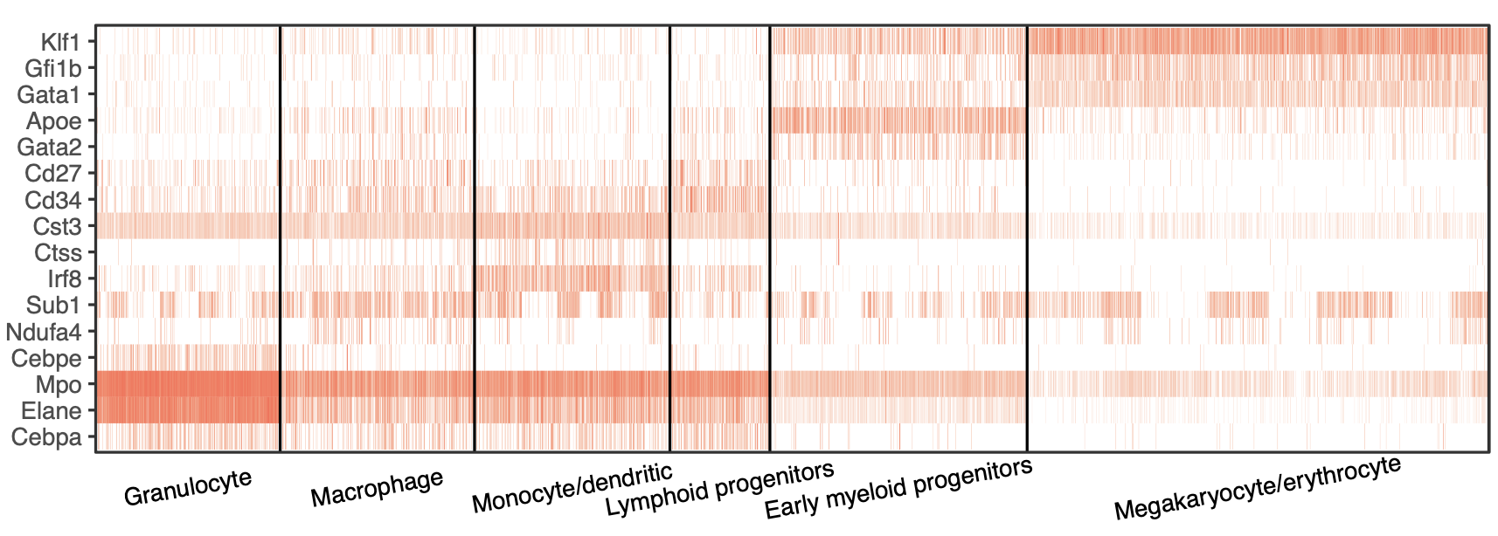
Bone marrow myeloid progenitor lineage
Early myeloid progenitor
Megakaryocyte/erythrocyte
Macrophage
Granulocyte/macrophage
Monocyte/dendritic
Lymphoid progenitor
Granulocyte

Slide 11
How about pathways?

Slide 12
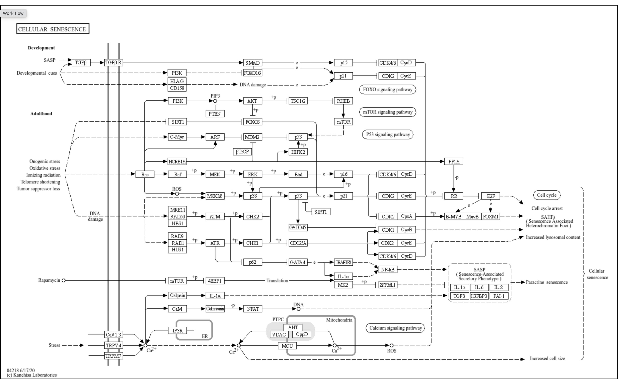
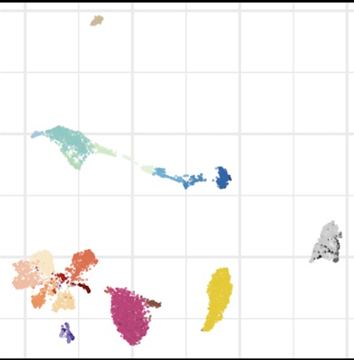


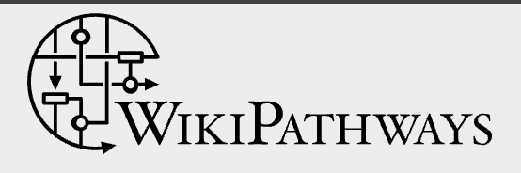

Public Databases
Pathway of Interest
Single-cell Dataset
Context-specific pathway activity test:
Active or Inactive?

Slide 13
Pathway

Slide 14
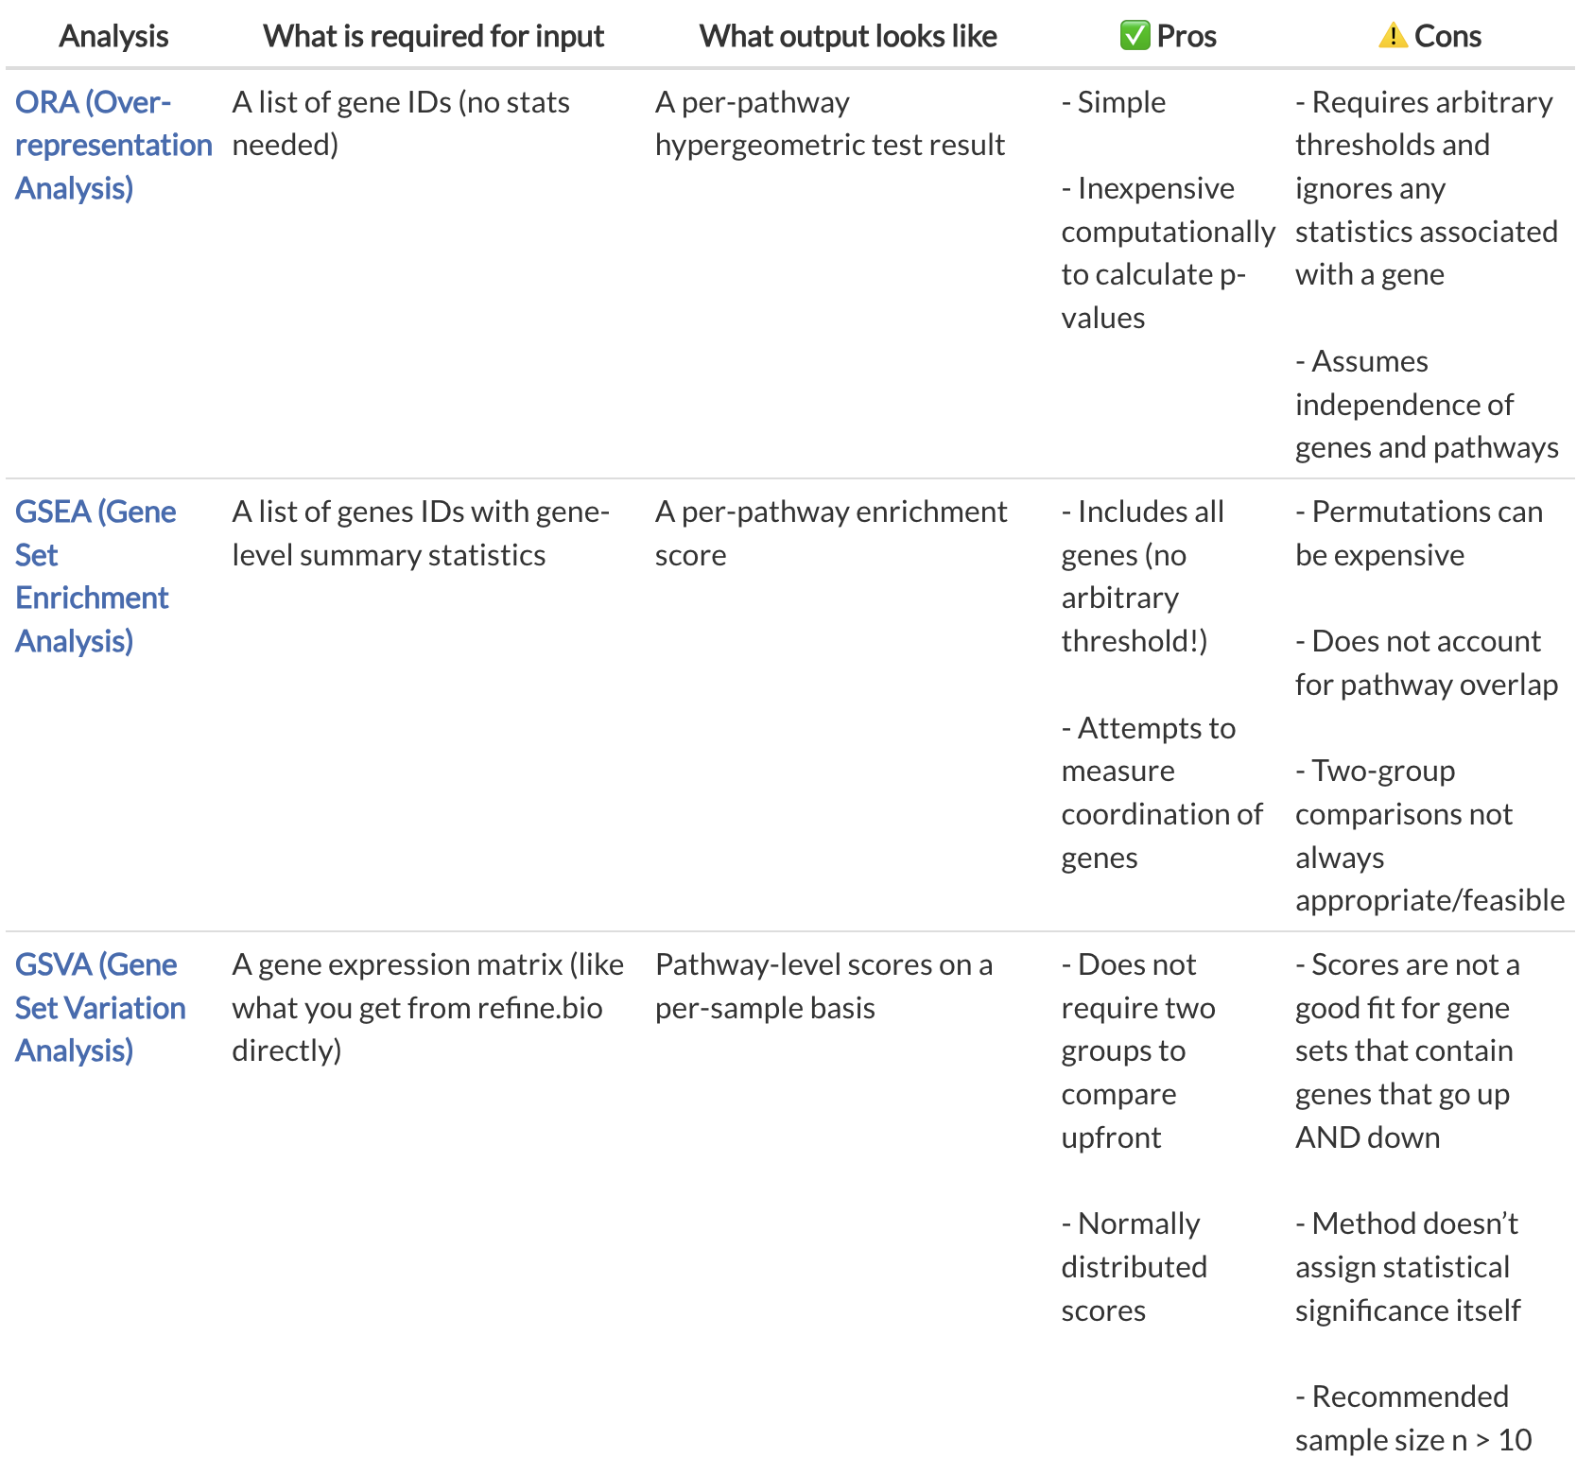
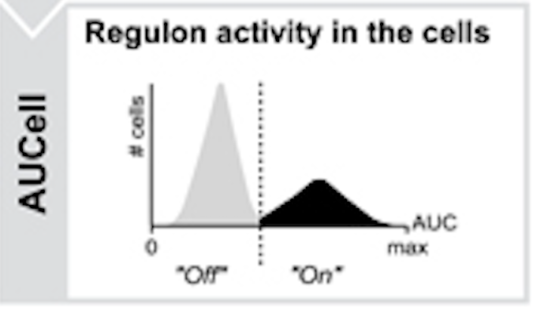
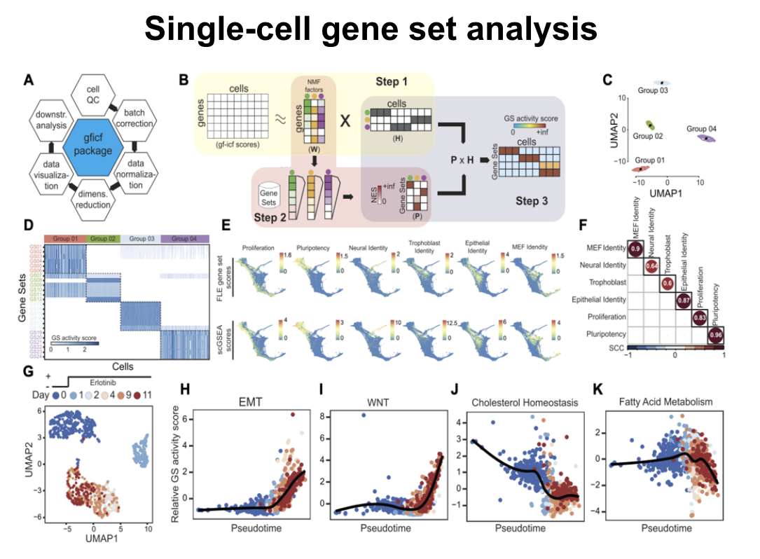
Traditional Pathway (Gene Set) Analysis
Current methods are all based on genes’ or gene-factors’ over- or under-expressions!

Slide 15
Gene Co-expression Graph
Gene Co-expression Graph
Nodes: Genes
Edges: Gene pair co-expression
Gene co-expression topology
feature genes
Pathway genes
Hub genes

Slide 16
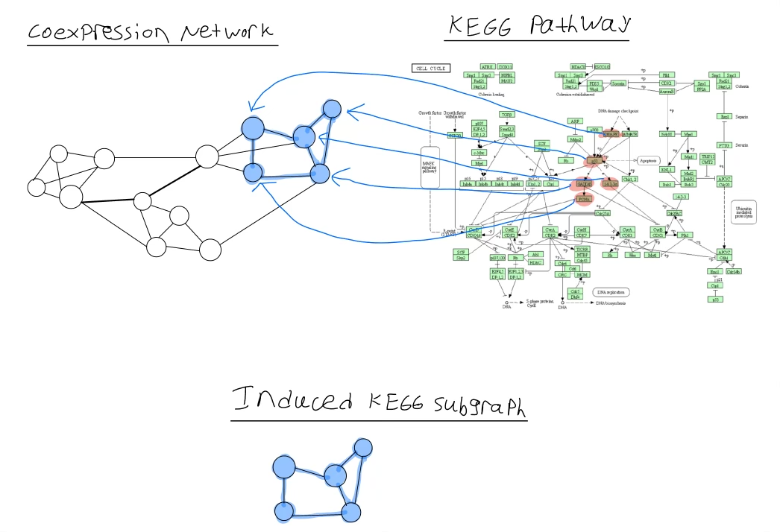
Pathway genes

Slide 18
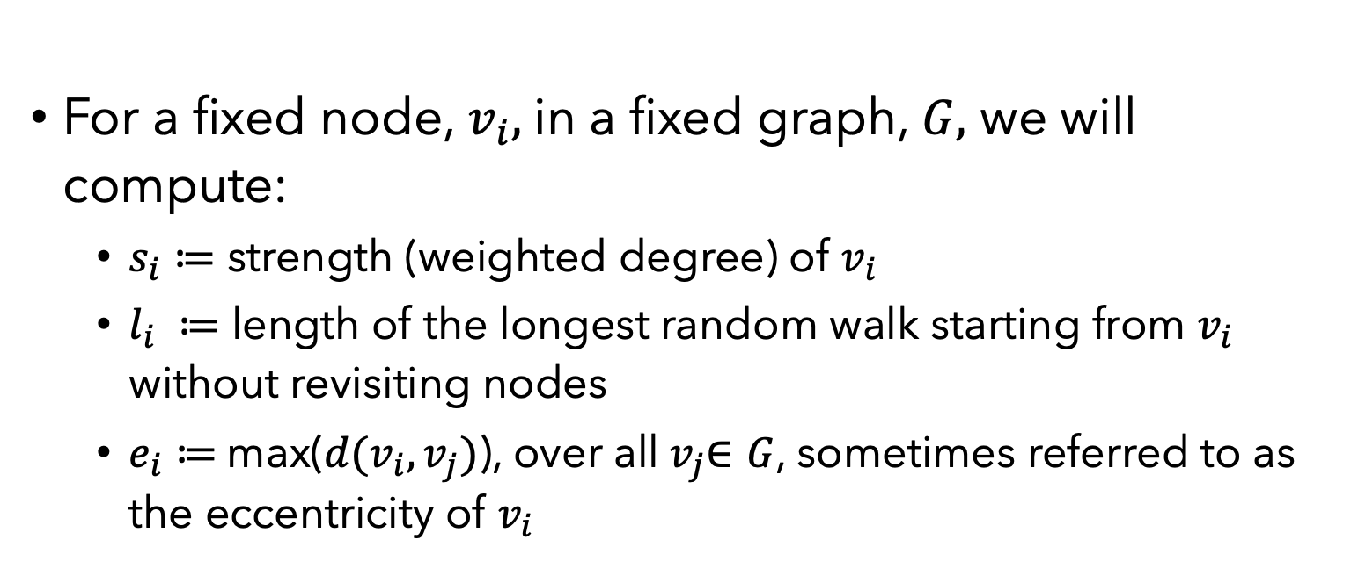
CPACT: Graph embeddings
For a fixed node, $v_{i},$in a fixed graph, $G,$ we will compute:
$s_{i}≔$ strength (weighted degree) of $v_{i}$
$l_{i} ≔$ length of the longest random walk starting from $v_{i}$ without revisiting nodes
$e_{i}≔$max($d(v_{i},v_{j})$), over all${ v}_{j}∈G$, sometimes referred to as the eccentricity of $v_{i}$

Slide 19
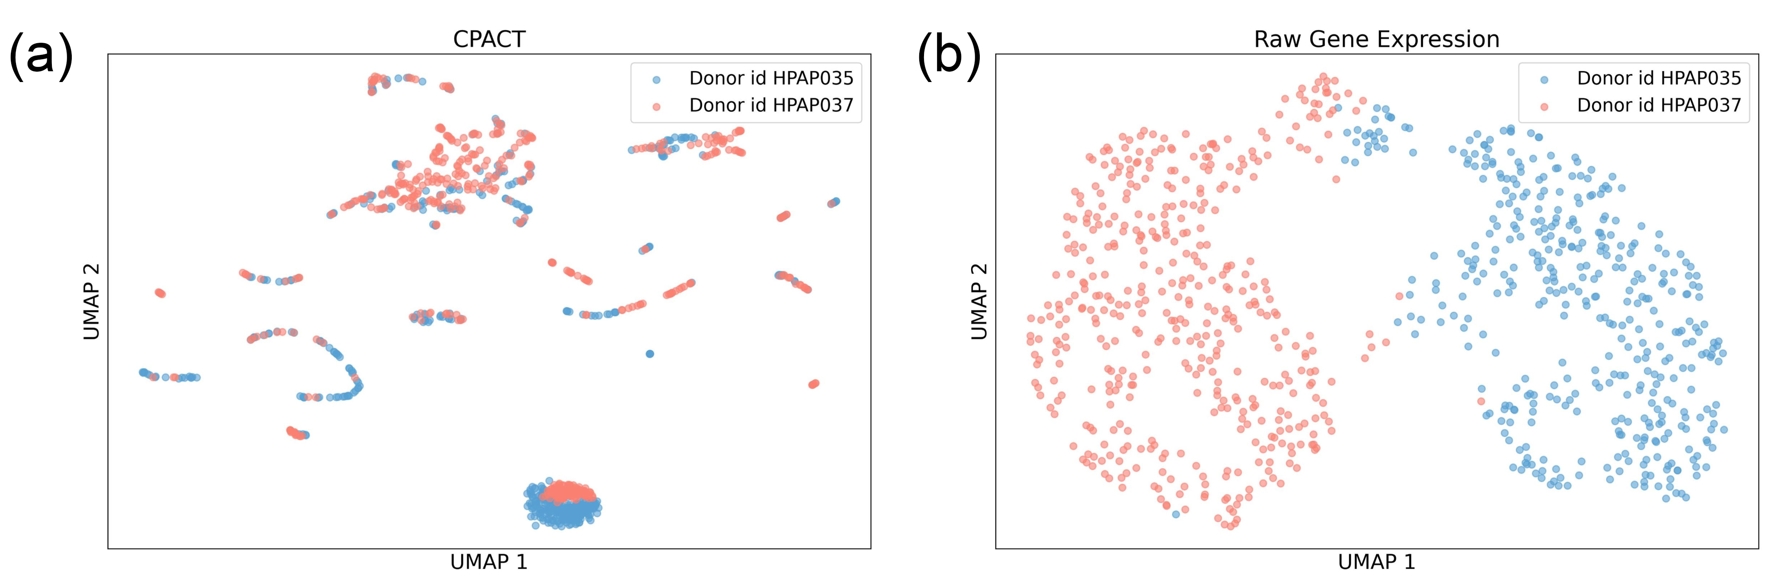
Batch effect

Slide 20
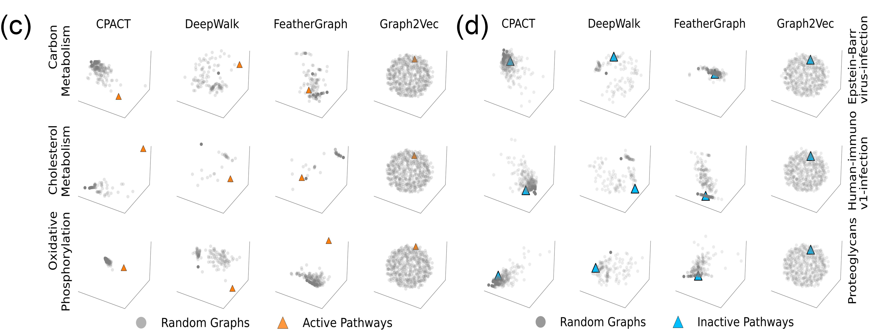
Active/Inactive pathway graph vs. Random graph

Slide 21
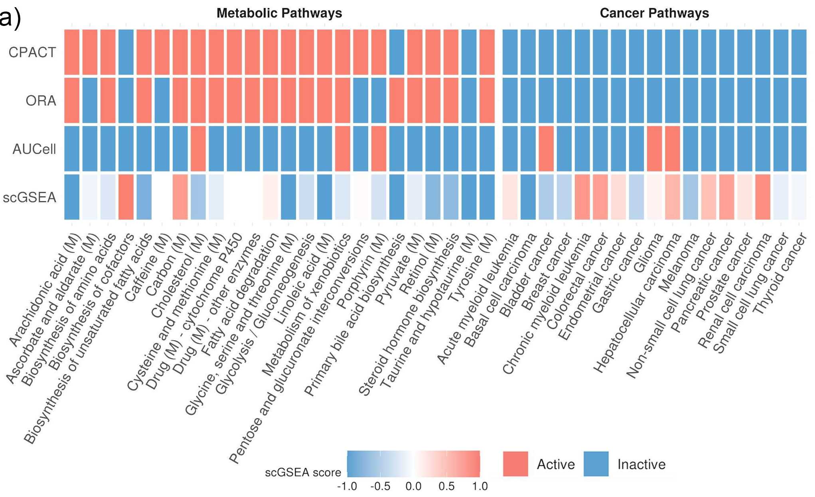
Normal Human Liver Hepatocytes Pathway Activeness

Slide 22
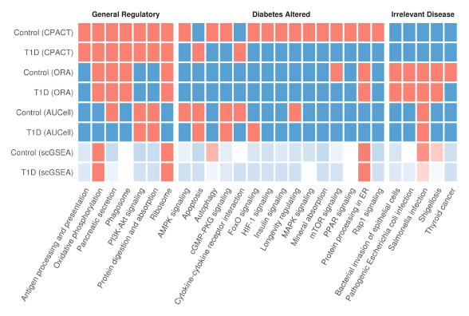
Pancreatic beta Cell Pathway Activeness

Slide 23
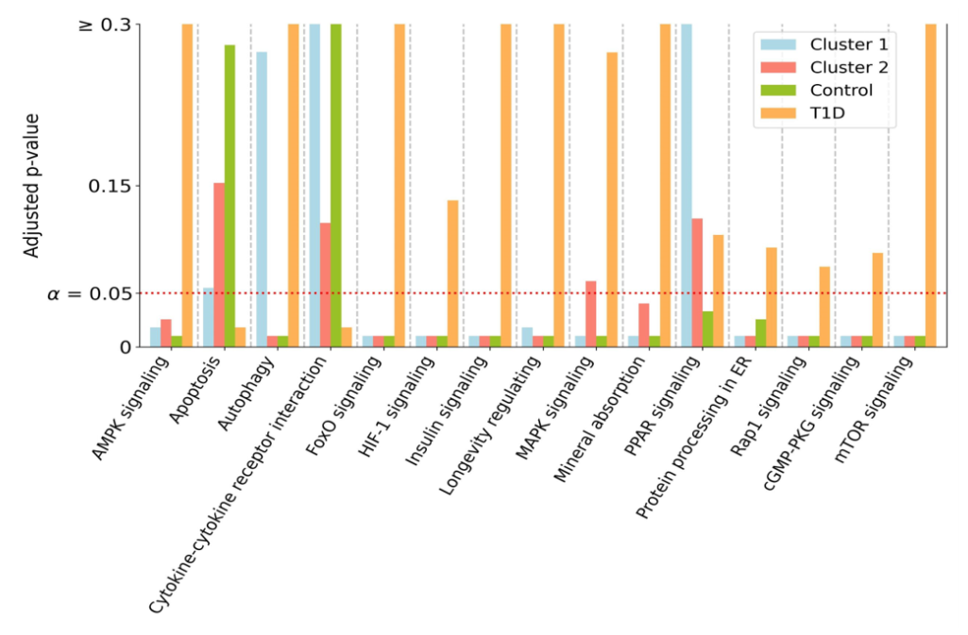
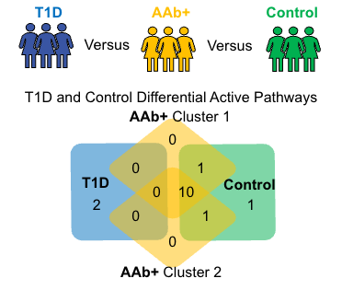
Patients with early sign of Type I diabetes
Human pancreatic beta cells from patients with early signs of diabetes

Slide 24
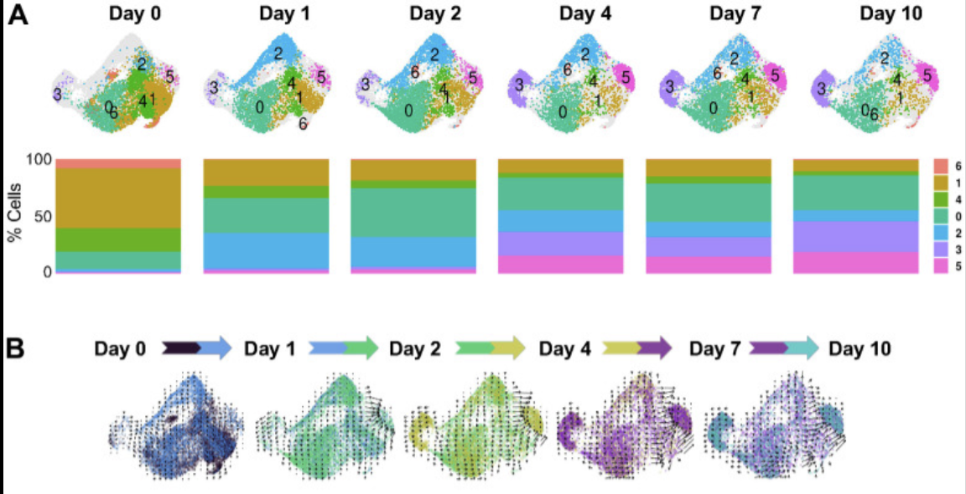
Cellular Senescence
Noah Wechter et al. Single-cell transcriptomic analysis uncovers diverse and dynamic senescent cell populations. Aging, 2023.

Slide 25
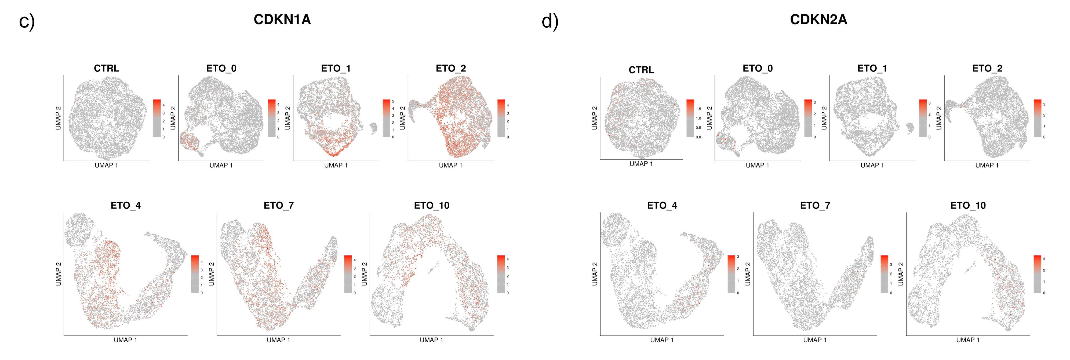
Cellular Senescence

Slide 26
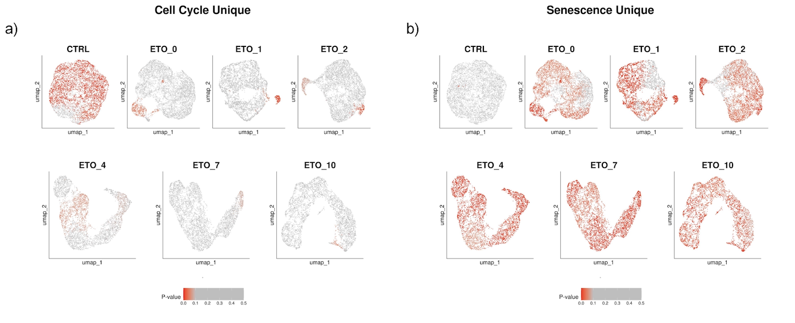
Cellular Senescence

Slide 27
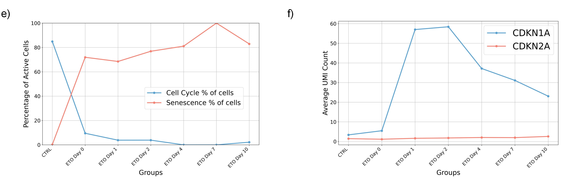
Cellular Senescence

Slide 28
Take Home Messages
Gene co-expression topology structure contain various biological information.
Analysis based on a single pair of genes (connected or not) is too noisy to achieve reliable results; however, regional or global topology analysis is more robust and accurate.

Slide 29




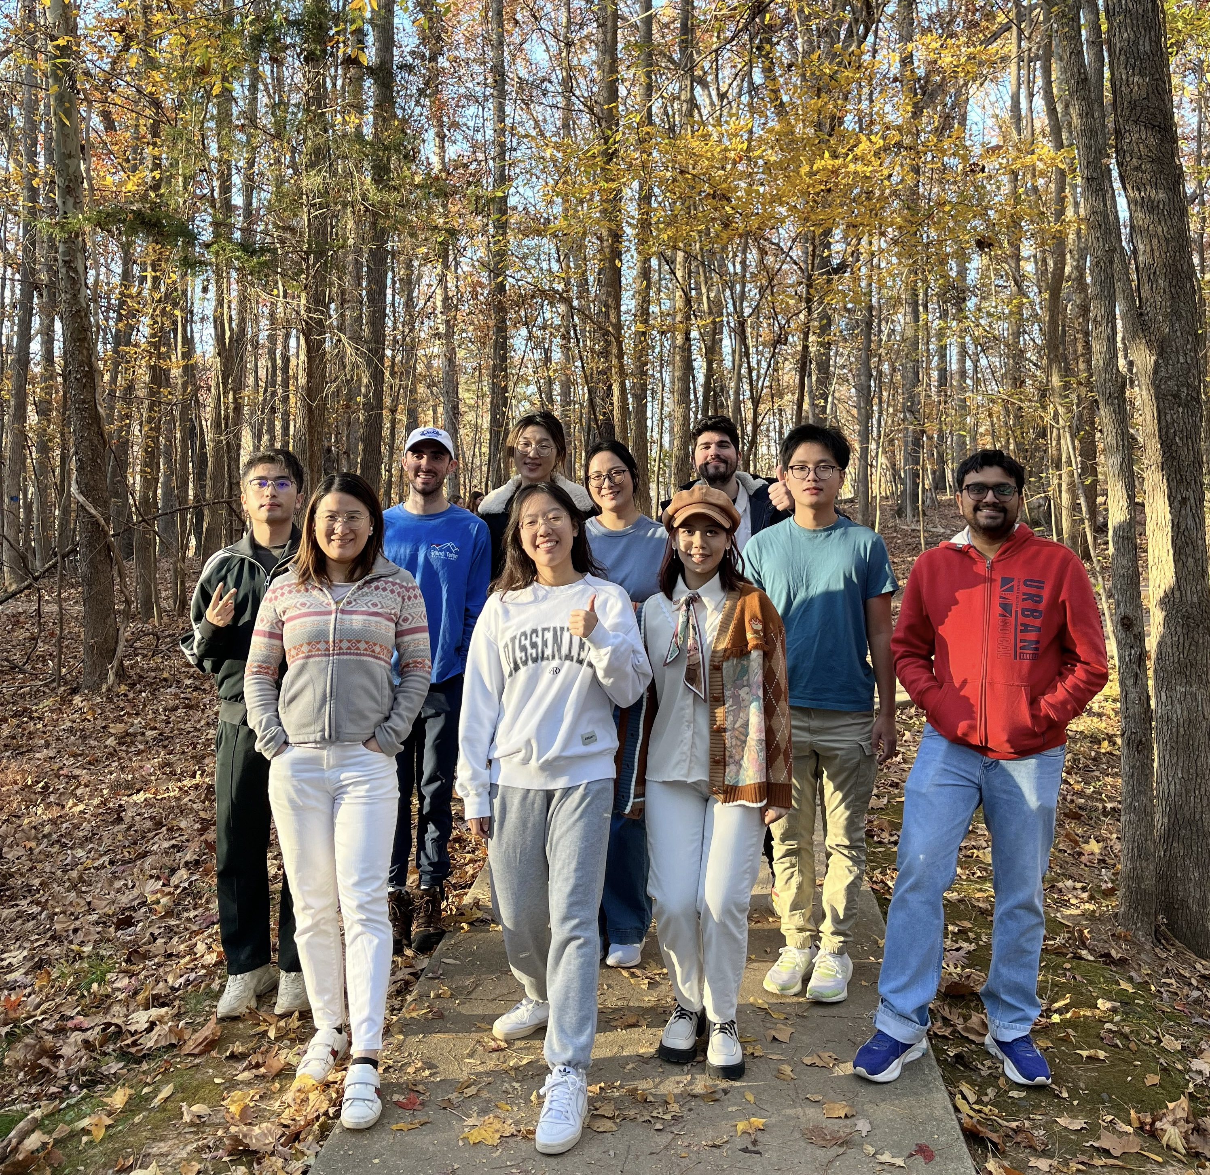

Leading members
Ph.D. student
Department of Mathematics
Duke University
R01HG012555
U54AG075936
Ph.D. alumni
Department of Biostatistics and Bioinformatics
Duke University
Collaborators
Cliburn Chan
Yarui Diao
Andrew Nixon
Xiaofan Wang

